Slide 1
Logistic Regression
Jurafsky and Martin Chapter 5

Slide 2
Notes:
The skip-gram model tries to shift embeddings so the target embedding (here for apricot) are closer to (have a higher dot product with) context embeddings for nearby words (here jam) and further from (have a lower dot product with) context embeddings for words that don’t occur nearby (here aardvark).
Note that the skip-gram model thus actually learns two separate embeddings for each word w: the target embedding t and the context embedding c. These embeddings are stored in two matrices, the target matrix T and the context matrix C. So each row i of the target matrix T is the 1 × d vector embedding ti for word i in the vocabulary V , and each column i of the context matrix C is a d × 1 vector embedding ci for word i in V . This figure shows an intuition of the learning task for the embeddings encoded in these two matrices.

Slide 3
Recap: How to learn word2vec (skip-gram) embeddings
Start with V random 300-dimensional vectors as initial embeddings
Use logistic regression to
Take a corpus and take pairs of words that co-occur as positive examples
Take pairs of words that don't co-occur as negative examples
Train the classifier to distinguish these by slowly adjusting all the embeddings to improve the classifier performance
Throw away the classifier code and keep the embeddings.
Notes:
Logistic regression is covered in Chapter 5 of the textbook

Slide 4
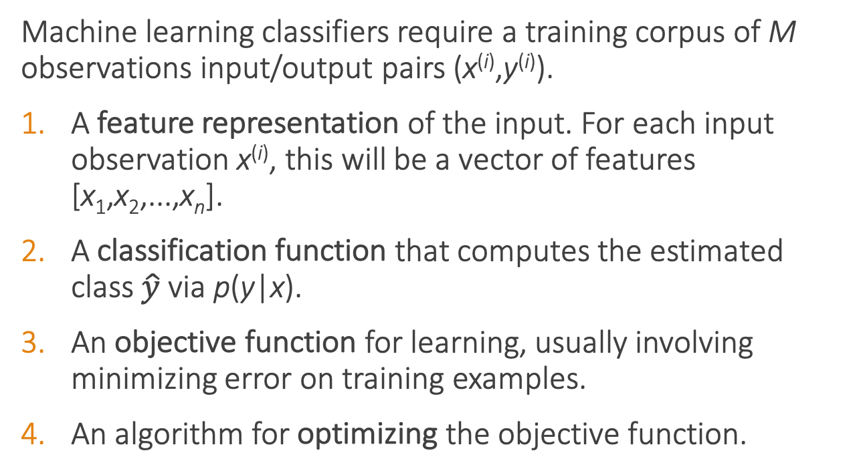
Classifier components
Machine learning classifiers require a training corpus of M observations input/output pairs (x^{(i)},y^{(i)}).
A feature representation of the input. For each input observation x^{(i)}, this will be a vector of features [x₁,x₂,...,x_{n}].
A classification function that computes the estimated class $\hat{y}$via p(y|x).
An objective function for learning, usually involving minimizing error on training examples.
An algorithm for optimizing the objective function.

Slide 5
Sentiment classifier
Input: "Spiraling away from narrative control as its first three episodes unreel, this series, about a post-apocalyptic future in which nearly everyone is blind, wastes the time of Jason Momoa and Alfre Woodard, among others, on a story that starts from a position of fun, giddy strangeness and drags itself forward at a lugubrious pace."
Output: positive (1) or negative (0)

Slide 6
Sentiment classifier
For sentiment classification, consider an input observation x, represented by a vector of features [x₁,x₂,...,x_{n}]. The classifier output y can be 1 (positive sentiment) or 0 (negative sentiment). We want to estimate P(y = 1|x).
Logistic regression solves this task by learning, from a training set, a vector of weights and a bias term.
We can also write this as a dot product:
Notes:
The weight wi represents how important that input feature is to the classification decision, and can be positive (meaning the feature is associated with the class) or negative (meaning the feature is not associated with the class). Thus we might expect in a sentiment task the word awesome to have a high positive weight, and abysmal to have a very negative weight. The bias term, also called the intercept, is another real number that’s added to the weighted inputs.
But note that nothing forces z to be a legal probability, that is, to lie between 0 and 1. In fact, since weights are real-valued, the output might even be negative; z ranges from −∞ to ∞.

Slide 7
Sigmoid function
Notes:
But note that nothing forces z to be a legal probability, that is, to lie between 0 and 1. In fact, since weights are real-valued, the output might even be negative; z ranges from −∞ to ∞.
To create a probability, we’ll pass z through the sigmoid function, σ(z). The sigmoid function (named because it looks like an s) is also called the logistic func- tion, and gives logistic regression its name.

Slide 8
Probabilities

Slide 9
Decision boundary
Now we have an algorithm that given an instance x computes the probability P(y = 1|x). How do we make a decision?
For a test instance x, we say yes if the probability P(y = 1|x) is more than .5, and no otherwise. We call .5 the decision boundary
Notes:
Now we have an algorithm that given an instance x computes the probability P(y = 1|x). How do we make a decision? For a test instance x, we say yes if the probability P(y = 1|x) is more than .5, and no otherwise. We call .5 the decision boundary

Slide 10
Extracting Features
It's hokey. There are virtually no surprises , and the writing is second-rate . So why was it so enjoyable? For one thing , the cast is great . Another nice touch is the music . I was overcome with the urge to get off the couch and start dancing . It sucked me in , and it'll do the same to you .
Var | Definition | Value
x₁ | Count of positive lexicon words
x₂ | Count of negative lexicon words
x₃ | Does no appear? (binary feature)
x₄ | Number of 1st and 2nd person pronouns
x₅ | Does ! appear? (binary feature)
x₆ | Log of the word count for the document

Slide 11
Extracting Features
It's hokey. There are virtually no surprises , and the writing is second-rate . So why was it so enjoyable? For one thing , the cast is great . Another nice touch is the music . I was overcome with the urge to get off the couch and start dancing . It sucked me in , and it'll do the same to you .
Var | Definition | Value
x₁ | Count of positive lexicon words | 3
x₂ | Count of negative lexicon words
x₃ | Does no appear? (binary feature)
x₄ | Number of 1st and 2nd person pronouns
x₅ | Does ! appear? (binary feature)
x₆ | Log of the word count for the document

Slide 12
Extracting Features
It's hokey. There are virtually no surprises , and the writing is second-rate . So why was it so enjoyable? For one thing , the cast is great . Another nice touch is the music . I was overcome with the urge to get off the couch and start dancing . It sucked me in , and it'll do the same to you .
Var | Definition | Value
x₁ | Count of positive lexicon words | 3
x₂ | Count of negative lexicon words | 2
x₃ | Does no appear? (binary feature)
x₄ | Number of 1st and 2nd person pronouns
x₅ | Does ! appear? (binary feature)
x₆ | Log of the word count for the document

Slide 13
Extracting Features
It's hokey. There are virtually no surprises , and the writing is second-rate . So why was it so enjoyable? For one thing , the cast is great . Another nice touch is the music . I was overcome with the urge to get off the couch and start dancing . It sucked me in , and it'll do the same to you .
Var | Definition | Value
x₁ | Count of positive lexicon words | 3
x₂ | Count of negative lexicon words | 2
x₃ | Does no appear? (binary feature) | 1
x₄ | Number of 1st and 2nd person pronouns
x₅ | Does ! appear? (binary feature)
x₆ | Log of the word count for the document

Slide 14
Extracting Features
It's hokey. There are virtually no surprises , and the writing is second-rate . So why was it so enjoyable? For one thing , the cast is great . Another nice touch is the music . I was overcome with the urge to get off the couch and start dancing . It sucked me in , and it'll do the same to you .
Var | Definition | Value
x₁ | Count of positive lexicon words | 3
x₂ | Count of negative lexicon words | 2
x₃ | Does no appear? (binary feature) | 1
x₄ | Number of 1st and 2nd person pronouns | 3
x₅ | Does ! appear? (binary feature)
x₆ | Log of the word count for the document

Slide 15
Extracting Features
It's hokey. There are virtually no surprises , and the writing is second-rate . So why was it so enjoyable? For one thing , the cast is great . Another nice touch is the music . I was overcome with the urge to get off the couch and start dancing . It sucked me in , and it'll do the same to you .
Word count = 64, ln(64) = 4.15
Var | Definition | Value
x₁ | Count of positive lexicon words | 3
x₂ | Count of negative lexicon words | 2
x₃ | Does no appear? (binary feature) | 1
x₄ | Number of 1st and 2nd person pronouns | 3
x₅ | Does ! appear? (binary feature) | 0
x₆ | Log of the word count for the document | 4.15

Slide 16
Var | Definition | Value | Weight | Product
x₁ | Count of positive lexicon words | 3 | 2.5
x₂ | Count of negative lexicon words | 2 | -5.0
x₃ | Does no appear? (binary feature) | 1 | -1.2
x₄ | Num 1st and 2nd person pronouns | 3 | 0.5
x₅ | Does ! appear? (binary feature) | 0 | 2.0
x₆ | Log of the word count for the doc | 4.15 | 0.7
b | bias | 1 | 0.1

Slide 17
Computing Z
Var | Definition | Value | Weight | Product
x₁ | Count of positive lexicon words | 3 | 2.5 | 7.5
x₂ | Count of negative lexicon words | 2 | -5.0 | -10
x₃ | Does no appear? (binary feature) | 1 | -1.2 | -1.2
x₄ | Num 1st and 2nd person pronouns | 3 | 0.5 | 1.5
x₅ | Does ! appear? (binary feature) | 0 | 2.0 | 0
x₆ | Log of the word count for the doc | 4.15 | 0.7 | 2.905
b | bias | 1 | 0.1 | .1
Z=0.805

Slide 18
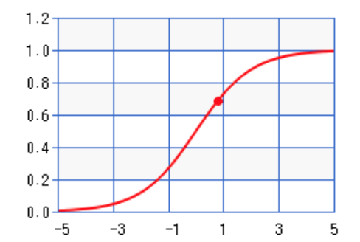
Sigmoid(Z)
Var | Definition | Value | Weight | Product
x₁ | Count of positive lexicon words | 3 | 2.5 | 7.5
x₂ | Count of negative lexicon words | 2 | -5.0 | -10
x₃ | Does no appear? (binary feature) | 1 | -1.2 | -1.2
x₄ | Num 1st and 2nd person pronouns | 3 | 0.5 | 1.5
x₅ | Does ! appear? (binary feature) | 0 | 2.0 | 0
x₆ | Log of the word count for the doc | 4.15 | 0.7 | 2.905
b | bias | 1 | 0.1 | .1
σ(0.805)
= 0.69
Notes:
So the probability that this is a positive review = 69%. The probability that it’s a negative review is 31%

Slide 19
Learning in logistic regression
How do we get the weights of the model? We learn the parameters (weights + bias) via learning. This requires 2 components:
An objective function or loss function that tells us distance between the system output and the gold output. We will use cross-entropy loss.
An algorithm for optimizing the objective function. We will use stochastic gradient descent to minimize the loss function.

Slide 20
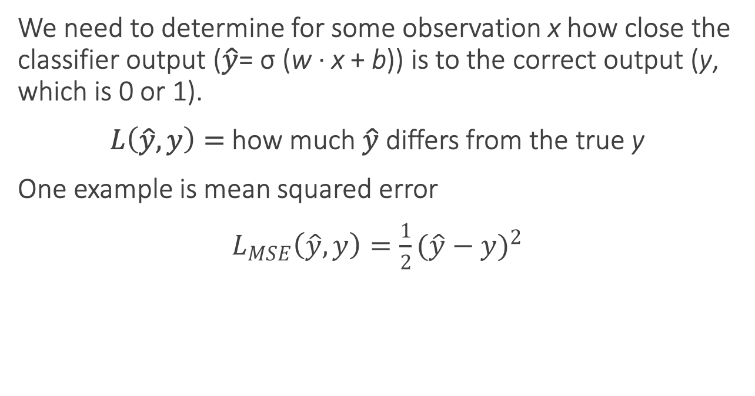
Loss functions
We need to determine for some observation x how close the classifier output ($\hat{y}$= σ (w · x + b)) is to the correct output (y, which is 0 or 1).
$L\left(\hat{y}, y\right)=$how much $\hat{y}$ differs from the true y
One example is mean squared error
$L_{MSE}\left(\hat{y}, y\right)=\frac{1}{2}{(\hat{y}−y)}^{2}$
Notes:
It turns out that this MSE loss, which is very useful for some algorithms like linear regression, becomes harder to optimize (technically, non-convex), when it’s applied to probabilistic classification.
https://towardsdatascience.com/why-not-mse-as-a-loss-function-for-logistic-regression-589816b5e03c

Slide 21
Loss functions for probabilistic classification
We use a loss function that prefers the correct class labels of the training example to be more likely.
Conditional maximum likelihood estimation: Choose parameters w, b that maximize the (log) probabilities of the true labels in the training data.
The resulting loss function is the negative log likelihood loss, more commonly called the cross entropy loss.

Slide 22
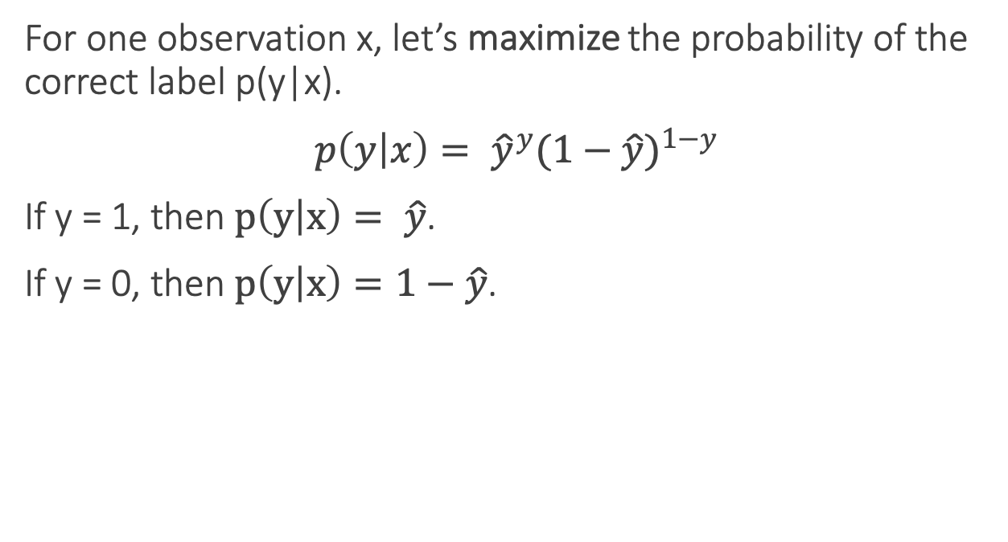
Loss functions for probabilistic classification
For one observation x, let’s maximize the probability of the correct label p(y|x).
$p\left(y | x\right)= {\hat{y}}^{y}{(1−\hat{y})}^{1−y}$
If y = 1, then $p\left(y | x\right)= \hat{y}$.
If y = 0, then $p\left(y | x\right)=1−\hat{y}$.

Slide 23
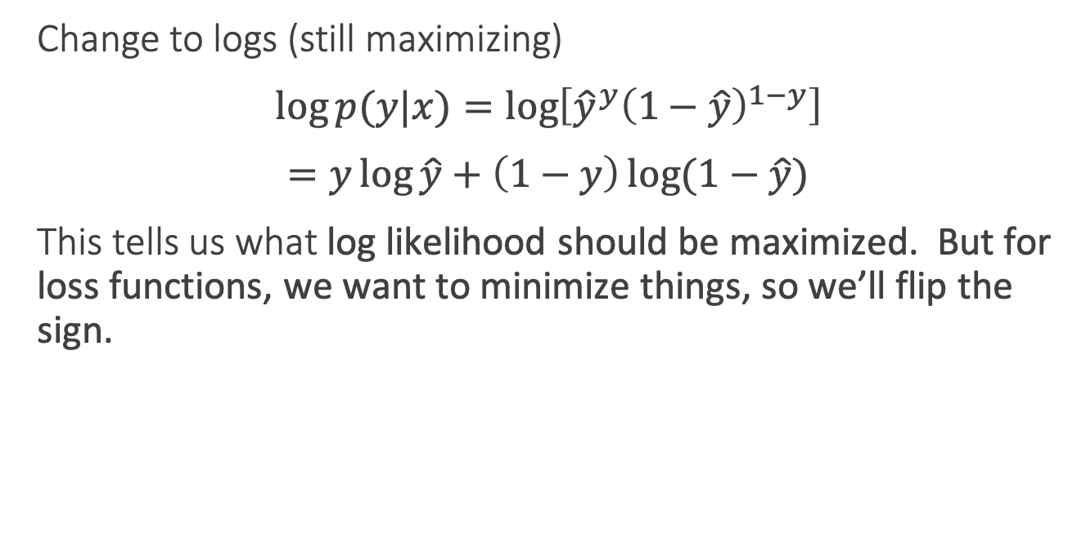
Loss functions for probabilistic classification
Change to logs (still maximizing)
$\log{p(y|x)}=\log\left[{\hat{y}}^{y}{\left(1−\hat{y}\right)}^{1−y}\right]$
$=y\log{\hat{y}}+\left(1−y\right)\log{(1−\hat{y})}$
This tells us what log likelihood should be maximized. But for loss functions, we want to minimize things, so we’ll flip the sign.

Slide 24
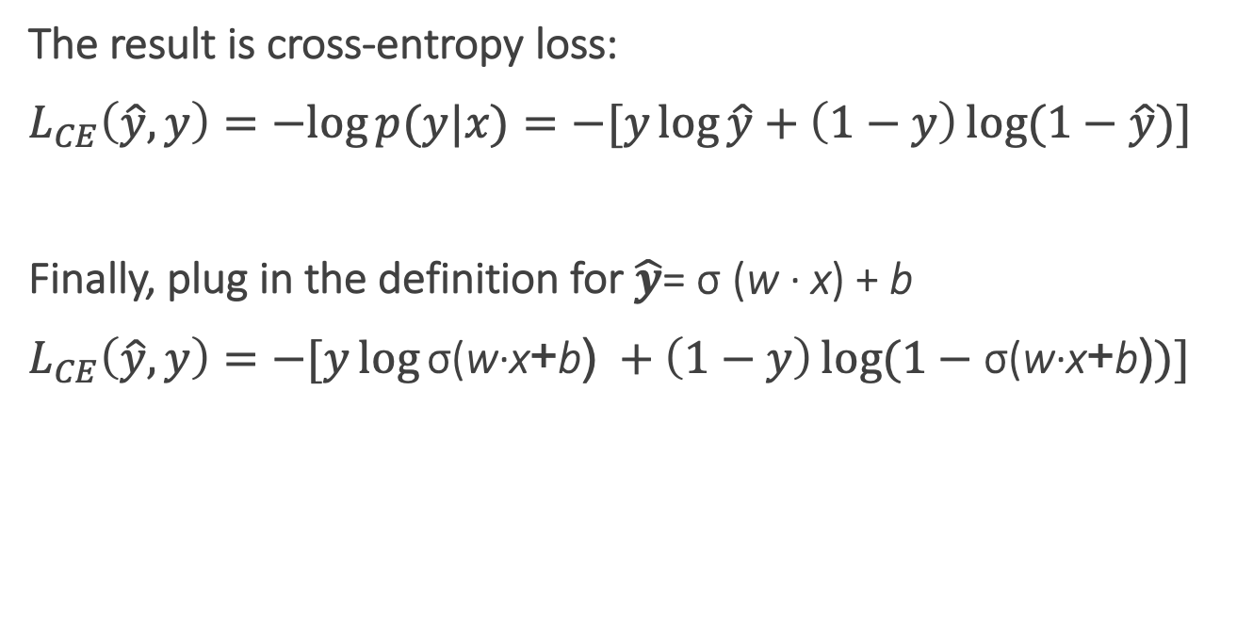
Cross-entropy loss
The result is cross-entropy loss:
$L_{CE}\left(\hat{y}, y\right)=−log{p(y|x)}=−[y\log{\hat{y}}+\left(1−y\right)\log{(1−\hat{y})]}$
Finally, plug in the definition for $\hat{y}$= σ (w · x) + b
$L_{CE}\left(\hat{y}, y\right)=−[y\log{\text{σ}\text{(}\text{w}\text{·}\text{x}\text{+}\text{b}\text{)} }+\left(1−y\right)\log{(1−\text{σ}\text{(}\text{w}\text{·}\text{x}\text{+}\text{b}\text{)})]}$
Notes:
In information theory, the cross entropy between two probability distributions p and q over the same underlying set of events measures the average number of bits needed to identify an event drawn from the set, if a coding scheme is used that is optimized for an "artificial" probability distribution q, rather than the "true" distribution p.
Information theoryEntropy
Differential entropy
Conditional entropy
Joint entropy
Mutual information
Conditional mutual information
Relative entropy
Entropy rate
Asymptotic equipartition property
Rate–distortion theory
Shannon's source coding theorem
Channel capacity
Noisy-channel coding theorem
Shannon–Hartley theorem
v

Slide 25
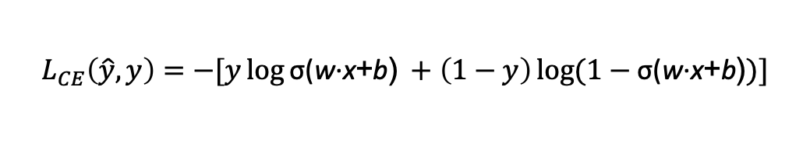
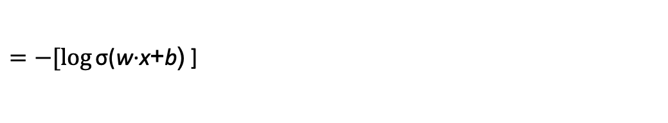
Cross-entropy loss
Why does minimizing this negative log probability do what we want? We want the loss to be smaller if the model’s estimate is close to correct, and we want the loss to be bigger if it is confused.
It's hokey. There are virtually no surprises , and the writing is second-rate . So why was it so enjoyable? For one thing , the cast is great . Another nice touch is the music . I was overcome with the urge to get off the couch and start dancing . It sucked me in , and it'll do the same to you .
P(sentiment=1|It’s hokey...) = 0.69. Let’s say y=1.
$$L_{CE}\left(\hat{y}, y\right)=−[y\log{\text{σ}\text{(}\text{w}\text{·}\text{x}\text{+}\text{b}\text{)} }+\left(1−y\right)\log{(1−\text{σ}\text{(}\text{w}\text{·}\text{x}\text{+}\text{b}\text{)})]}$$
$=−[\log{\text{σ}\text{(}\text{w}\text{·}\text{x}\text{+}\text{b}\text{)} }$]
$$=−\log{\text{(}\text{0.69}\text{)}=0.37}$$
Notes:
This loss function also ensures that as probability of the correct answer is maximized, the probability of the incorrect answer is minimized; since the two sum to one, any increase in the probability of the correct answer is coming at the expense of the incorrect answer.

Slide 26
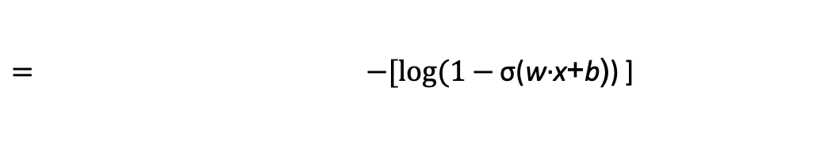
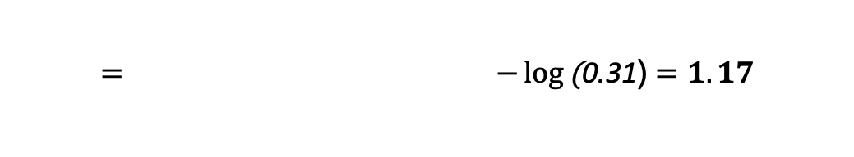
Cross-entropy loss
Why does minimizing this negative log probability do what we want? We want the loss to be smaller if the model’s estimate is close to correct, and we want the loss to be bigger if it is confused.
It's hokey. There are virtually no surprises , and the writing is second-rate . So why was it so enjoyable? For one thing , the cast is great . Another nice touch is the music . I was overcome with the urge to get off the couch and start dancing . It sucked me in , and it'll do the same to you .
P(sentiment=1|It’s hokey...) = 0.69. Let’s pretend y=0.
$$L_{CE}\left(\hat{y}, y\right)=−[y\log{\text{σ}\text{(}\text{w}\text{·}\text{x}\text{+}\text{b}\text{)} }+\left(1−y\right)\log{(1−\text{σ}\text{(}\text{w}\text{·}\text{x}\text{+}\text{b}\text{)})]}$$
$= −[log(1−{\text{σ}\text{(}\text{w}\text{·}\text{x}\text{+}\text{b}\text{)}\text{)} }$]
$$= −\log{\text{(}\text{0.31}\text{)}=1.17}$$
Notes:
This loss function also ensures that as probability of the correct answer is maximized, the probability of the incorrect answer is minimized; since the two sum to one, any increase in the probability of the correct answer is coming at the expense of the incorrect answer.

Slide 27
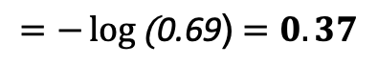
Cross-entropy loss
Why does minimizing this negative log probability do what we want? We want the loss to be smaller if the model’s estimate is close to correct, and we want the loss to be bigger if it is confused.
It's hokey. There are virtually no surprises , and the writing is second-rate . So why was it so enjoyable? For one thing , the cast is great . Another nice touch is the music . I was overcome with the urge to get off the couch and start dancing . It sucked me in , and it'll do the same to you .
If our prediction is correct, then our CE loss is lower
If our prediction is incorrect, then our CE loss is higher
$$=−\log{\text{(}\text{0.69}\text{)}=0.37}$$
$−\log{\text{(}\text{0.31}\text{)}=1.17}$
Notes:
Why does minimizing this negative log probability do what we want? A per- fect classifier would assign probability 1 to the correct outcome (y=1 or y=0) and probability 0 to the incorrect outcome. That means the higher yˆ (the closer it is to 1), the better the classifier; the lower yˆ is (the closer it is to 0), the worse the clas- sifier. The negative log of this probability is a convenient loss metric since it goes from 0 (negative log of 1, no loss) to infinity (negative log of 0, infinite loss). This loss function also ensures that as the probability of the correct answer is maximized, the probability of the incorrect answer is minimized; since the two sum to one, any increase in the probability of the correct answer is coming at the expense of the in- correct answer.

Slide 28
Loss on all training examples

Slide 29
Finding good parameters
We use gradient descent to find good settings for our weights and bias by minimizing the loss function.
Gradient descent is a method that finds a minimum of a function by figuring out in which direction (in the space of the parameters θ) the function’s slope is rising the most steeply, and moving in the opposite direction.
Notes:
Our goal with gradient descent is to find the optimal weights: minimize the loss function we’ve defined for the model. In Eq. 5.16 below, we’ll explicitly represent the fact that the loss function L is parameterized by the weights, which we’ll refer to in machine learning in general as θ (in the case of logistic regression θ = w, b)

Slide 30
Gradient descent
Notes:
The intuition is that if you are skiing in a canyon and trying to descend most quickly down to the river at the bottom, you might look around yourself 360 degrees, find the direction where the ground is sloping the steepest, and godownhill in that direction.

Slide 31
Global v. Local Minimums
For logistic regression, this loss function is conveniently convex.
A convex function has just one minimum, so there are no local minima to get stuck in.
So gradient descent starting from any point is guaranteed to find the minimum.
Notes:
By contrast, the loss for multi-layer neural networks is non-convex, and gradient descent may get stuck in local minima for neural network training and never find the global optimum

Slide 32
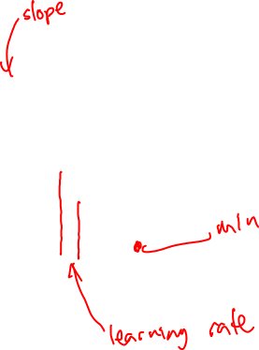
Iteratively find minimum
Notes:
The gradient descent algorithm answers this question by finding the gradient of the loss function at the current point and moving in the opposite direction. The gradient of a function of many variables is a vector pointing in the direction the greatest increase in a function. The gradient is a multi-variable generalization of the slope, so for a function of one variable like the one in Fig. 5.3, we can informally think of the gradient as the slope. The dotted line in Fig. 5.3 shows the slope of this hypothetical loss function at point w = w1. You can see that the slope of this dotted line is negative. Thus to find the minimum, gradient descent tells us to go in the opposite direction: moving w in a positive direction.
The first step in iteratively finding the minimum of this loss function, by moving w in the reverse direction from the slope of the function. Since the slope is negative, we need to move w in a positive direction, to the right. Here superscripts are used for learning steps, so w1 means the initial value of w (which is 0), w2 at the second step, and so on.

Slide 33

How much should we update the parameter by?
The magnitude of the amount to move in gradient descent is the value of the slope weighted by a learning rate η.
A higher/faster learning rate means that we should move w more on each step.
Notes:
η = eta. Is the learning rate
The change we make in our parameter is the
learning rate times the gradient (or the slope, in our single-variable example)
In each dimension wi, we express the slope as a partial derivative ∂ of the loss ∂wi
function.
The magnitude of the amount to move in gradient descent is the value of the slope d f (x; w) weighted by a learning rate η . A higher (faster) learning rate means that
dw we should move w more on each step. The change we make in our parameter is the
learning rate times the gradient (or the slope, in our single-variable example):

Slide 34
Many dimensions
Notes:
Now let’s extend the intuition from a function of one scalar variable w to many variables, because we don’t just want to move left or right, we want to know where in the N-dimensional space (of the N parameters that make up θ ) we should move. The gradient is just such a vector; it expresses the directional components of the sharpest slope along each of those N dimensions. If we’re just imagining two weight dimension (say for one weight w and one bias b), the gradient might be a vector with two orthogonal components, each of which tells us how much the ground slopes in the w dimension and in the b dimension.
In an actual logistic regression, the parameter vector w is much longer than 1 or 2, since the input feature vector x can be quite long, and we need a weight wi for each xi For each dimension/variable wi in w (plus the bias b), the gradient will have a component that tells us the slope with respect to that variable. Essentially we’re asking: “How much would a small change in that variable wi influence the total loss function L?”

Slide 35
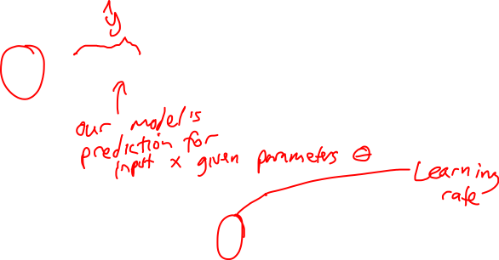
Updating each dimension w_{i}
The final equation for updating θ based on the gradient is
Notes:
In an actual logistic regression, the parameter vector w is much longer than 1 or 2, since the input feature vector x can be quite long, and we need a weight wi for each xi For each dimension/variable wi in w (plus the bias b), the gradient will have a component that tells us the slope with respect to that variable. Essentially we’re asking: “How much would a small change in that variable wi influence the total loss function L?”
In each dimension wi, we express the slope as a partial derivative ∂ of the loss ∂wi
function. The gradient is then defined as a vector of these partials. We’ll represent yˆ as f (x; θ ) to make the dependence on θ more obvious.
∇: Del, or nabla, is an operator used in mathematics, in particular in vector calculus, as a vector differential operator, usually represented by the nabla symbol ∇.

Slide 36
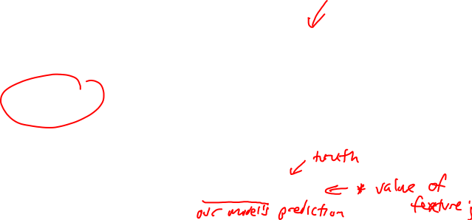
The Gradient
To update θ, we need a definition for the gradient ∇L( f (x; θ ), y).
For logistic regression the cross-entropy loss function is:
The derivative of this function for one observation vector x for a single weight w_{j} is
The gradient is a very intuitive value: the difference between the true y and our estimate for x, multiplied by the corresponding input value x_{j} .
Notes:
Note in Eq. 5.17 that the gradient with respect to a single weight w j represents a very intuitive value: the difference between the true y and our estimated yˆ = σ (w · x + b) for that observation, multiplied by the corresponding input value x j .

Slide 37
Average Loss
This is what we want to minimize!!

Slide 38
The Gradient
The loss for a batch of data or an entire dataset is just the average loss over the m examples
The gradient for multiple data points is the sum of the individual gradients:

Slide 39
Stochastic gradient descent algorithm
Notes:
Stochastic gradient descent is an online algorithm that minimizes the loss function by computing its gradient after each training example, and nudging θ in the right direction (the opposite direction of the gradient).
Stochastic gradient descent is called stochastic because it chooses a single random example at a time, moving the weights so as to improve performance on that single example. That can result in very choppy movements, so it’s also common to do minibatch gradient descent, which computes the gradient over batches of train- ing instances rather than a single instance.
The learning rate η is a parameter that must be adjusted. If it’s too high, the learner will take steps that are too large, overshooting the minimum of the loss func- tion. If it’s too low, the learner will take steps that are too small, and take too long to get to the minimum. It is most common to begin the learning rate at a higher value, and then slowly decrease it, so that it is a function of the iteration k of training; you will sometimes see the notation ηk to mean the value of the learning rate at iteration k.

Slide 40
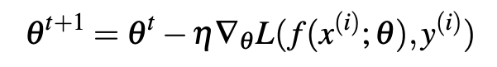
Worked example
Let’s walk though a single step of the gradient descent algorithm. We’ll use a simple sentiment classifier with just 2 features, and 1 training instance where the correct value is y = 1 (this is a positive review).
x₁ = 3 (count of positive lexicon words)
x₂ = 2 (count of positive negative words)
The initial weights and bias in θ⁰ are all set to 0, and the initial learning rate η is 0.1:
w₁ = w₂ = b = 0
η = 0.1
The single update step requires that we compute the gradient, multiplied by the learning rate:
Notes:
todo – add the worked example from textbook sectino 5.4.3

Slide 41
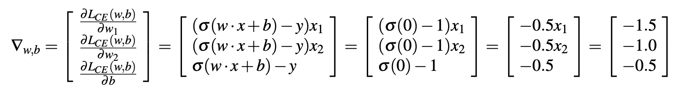
Worked example
The derivative of this function for one observation vector x for a single weight w_{j} is
The gradient vector has 3 dimensions, for w₁, w₂, and b. For our input, x₁ = 3 and x₂ = 2
x₂ = 2
Notes:
todo – add the worked example from textbook sectino 5.4.3

Slide 42
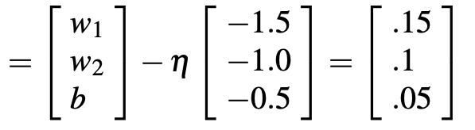
Worked example
Now that we have a gradient ∇_{w,b} , we compute the new parameter vector θ¹ by moving θ⁰ in the opposite direction from the gradient:
So after one step of gradient descent, the weights have shifted to be:
w₁ = 0.15, w₂ = 0.1, and b= .05
θ¹
Notes:
Note that this observation x happened to be a positive example. We would expect that after seeing more negative examples with high counts of negative words, that the weight w2 would shift to have a negative value.

Slide 43
Neural Networks
The building block of a neural network is a single computational unit. A unit takes a set of real valued numbers as input, performs some computation.

Slide 44
Neural Networks: A brain-inspired metaphor

Slide 45
A single neuron
Notes:
As the name suggests, neural networks were inspired by the brain’s computation mechanism, which consists of computation units called neurons. While the connections between artificial neural networks and the brain are in fact rather slim, we repeat the metaphor here for complete- ness. In the metaphor, a neuron is a computational unit that has scalar inputs and outputs. Each input has an associated weight. e neuron multiplies each input by its weight, and then sums1 them, applies a nonlinear function to the result, and passes it to its output. Figure 4.1 shows such a neuron.

Slide 46
Neural networks
Notes:
The neurons are connected to each other, forming a network: the output of a neuron may feed into the inputs of one or more neurons. Such networks were shown to be very capable computational devices. If the weights are set correctly, a neural network with enough neurons and a nonlinear activation function can approximate a very wide range of mathematical functions (we will be more precise about this later).
A typical feed-forward neural network may be drawn as shown. Each circle is a neuron, with incoming arrows being the neuron’s inputs and outgoing arrows being the neuron’s outputs. Each arrow carries a weight, reflecting its importance (not shown). Neurons are arranged in layers, reflecting the flow of information. The bottom layer has no incoming arrows, and is
the input to the network. the top-most layer has no outgoing arrows, and is the output of the network. The other layers are considered “hidden.” thee sigmoid shape inside the neurons in the middle layers represent a nonlinear function (i.e., the logistic function) that is applied to the neuron’s value before passing it to the output. In the figure, each neuron is connected to all of the neurons in the next layer—this is called a fully connected layer or an affine layer.

Slide 47
Review: Perceptron
Perceptrons were developed in the 1950s and 1960s loosely inspired by the neuron.

Slide 48
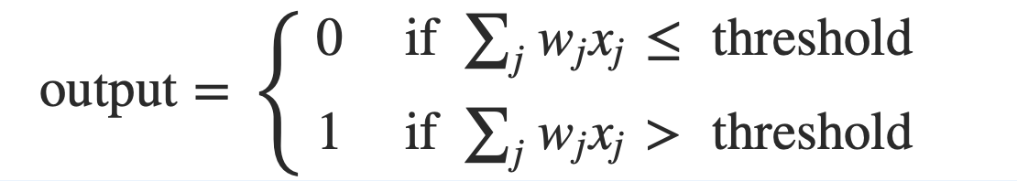
Review: Perceptron
Perceptron has inputs, x₁,x₂, .. x_{N}, and weights w₁,w₂, .. w_{N}
The perceptron outputs 0 or 1, based on the weighted sum is less than or greater than a threshold value

Slide 49
Perceptrons for decision making
We can think about the perceptron as a device that makes decisions by weighing up evidence.
Example: Suppose there’s a cheese festival in your town. You like cheese.

Slide 50
Perceptrons for decision making
You might use 3 factors to decide whether to go.
Is the weather good?
Can your loyal companion come with you?
Is the festival near public transit?
These can be the binary input values to a perceptron

Slide 51
Perceptrons for decision making
By varying weights and the threshold we get different models of decision making
Example 1: w₁= 6 w₂ = 2 w₃ = 2, threshold = 5
Example 2: w₁= 6 w₂ = 2 w₃ = 2, threshold = 3
Notes:
Example 1: You adore cheese so much you’re happy to go without your loyal companion, even if it’s hard to get to, but you hate bad weather
Example 2: Lower the threshold to 3. Then the perceptron would decide that you should go to the festival whenever the weather was good or when both the festival was near public transit and your boyfriend or girlfriend was willing to join you.
Obviously, the perceptron isn't a complete model of human decision-making! But what the example illustrates is how a perceptron can weigh up different kinds of evidence in order to make decisions

Slide 52
Perceptrons for decision making
A complex network of perceptrons could make quite subtle decisions:
Layer 3
Complex decisions can be made by the perceptron in the third layer
Layer 1
Layer 2
1st layer makes 3 simple decisions by weighing the input evidence
2nd layer makes a decision by weighing up the results from the 1st layer of decision-making
Notes:
In this network, the first column of perceptrons - what we'll call the first layer of perceptrons - is making three very simple decisions, by weighing the input evidence. What about the perceptrons in the second layer? Each of those perceptrons is making a decision by weighing up the results from the first layer of decision-making. In this way a perceptron in the second layer can make a decision at a more complex and more abstract level than perceptrons in the first layer. And even more complex decisions can be made by the perceptron in the third layer. In this way, a many-layer network of perceptrons can engage in sophisticated decision making.

Slide 53
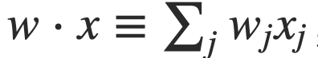
Weights, bias and dot products
Two notational changes simplify the way that perceptrons are described.
The first change is to replace the weighted sum as a dot product
The second change is to move the threshold to the other side of the inequality, and to replace it by a bias, b≡−threshold
Notes:
You can think of the bias as a measure of how easy it is to get the perceptron to output a 1. Or to put it in more biological terms, the bias is a measure of how easy it is to get the perceptron to fire. For a perceptron with a really big bias, it's extremely easy for the perceptron to output a 1. But if the bias is very negative, then it's difficult for the perceptron to output a 1.

Slide 54
Decision making OR logical functions
Perceptrons can be used is to compute logical functions like AND, OR and NAND
Example:
Input | Weighted sum | Output
00 | -2*0 + -2*0 +3 = 3 | 1
10 or 01 | -2*1 + -2*0 +3 = 1 | 1
11 | -2*1 + -2*1 +3 = -1 | 0
weights
bias
Notes:
So far, we have thought of perceptrons as a method for weighing evidence to make decisions. Another way perceptrons can be used is to compute the elementary logical functions we usually think of as underlying computation, functions such as AND, OR, and NAND. For example, suppose we have a perceptron with two inputs, each with weight−2, and an overall bias of 3.
What logical operator does this represent? This is a NAND gate!

Slide 55
Logical functions
Networks of perceptrons to compute any logical function
We can build any computation up out of NAND gates.
For example, a circuit which adds two bits x₁ and x₂
All unlabeled weights are -2, all biases =3.
Notes:
we can use networks of perceptrons to compute any logical function at all. The reason is that the NAND gate is universal for computation, that is, we can build any computation up out of NAND gates.
The NAND example shows that we can use perceptrons to compute simple logical functions. In fact, we can use networks of perceptrons to compute any logical function at all. The reason is that the NAND gate is universal for computation, that is, we can build any computation up out of NAND gates. For example, we can use NAND gates to build a circuit which adds two bits, x1 and x2. This requires computing the bitwise sum, x1⊕x2x1⊕x2, as well as a carry bit which is set to 1 when both x1 and x2 are 1, i.e., the carry bit is just the bitwise product x1x2:

Slide 56
Power of Perceptrons
Networks of Perceptrons are universal for computation, like NAND gates
Perceptrons can be as powerful as any other computing device!
We can devise learning algorithms to automatically tune the weights and biases of a network of artificial neurons
Instead of laying out a circuit of NAND and other gates, neural networks can simply learn to solve problems
Notes:
The adder example demonstrates how a network of perceptrons can be used to simulate a circuit containing many NAND gates. And because NAND gates are universal for computation, it follows that perceptrons are also universal for computation.
The computational universality of perceptrons is simultaneously reassuring and disappointing. It's reassuring because it tells us that networks of perceptrons can be as powerful as any other computing device. But it's also disappointing, because it makes it seem as though perceptrons are merely a new type of NAND gate. That's hardly big news!
However, the situation is better than this view suggests. It turns out that we can devise learning algorithms which can automatically tune the weights and biases of a network of artificial neurons. This tuning happens in response to external stimuli, without direct intervention by a programmer. These learning algorithms enable us to use artificial neurons in a way which is radically different to conventional logic gates. Instead of explicitly laying out a circuit of NAND and other gates, our neural networks can simply learn to solve problems, sometimes problems where it would be extremely difficult to directly design a conventional circuit.

Slide 57
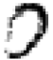




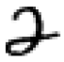
Learning to classify digits
Input: image encoded input as a vector of intensities:
Output: is this a one or not?
Goal: set the parameters of the network to correctly classify the digits
Learning = changing the weights an biases in the network.
0
1
0
0
1
0
Notes:
Learning algorithms sound terrific. But how can we devise such algorithms for a neural network? Suppose we have a network of perceptrons that we'd like to use to learn to solve some problem. For example, the inputs to the network might be the raw pixel data from a scanned, handwritten image of a digit. And we'd like the network to learn weights and biases so that the output from the network correctly classifies the digit. To see how learning might work, suppose we make a small change in some weight (or bias) in the network. What we'd like is for this small change in weight to cause only a small corresponding change in the output from the network. As we'll see in a moment, this property will make learning possible. Schematically, here's what we want (obviously this network is too simple to do handwriting recognition!):

Slide 58
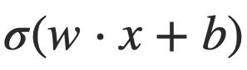
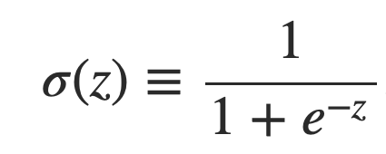
Sigmoid neurons
Problem: a small change in the weights or bias of any single perceptron in the network can causes the output to completely flip from 0 to 1.
Solution: sigmoid neuron
Perceptron
Sigmoid neuron
output =
Output is no longer just 1 or 0.
Same weights and bias as perceptron
Sigmoid function:
Inputs: any real-valued number
Notes:
That flip may then cause the behavior of the whole network to change in a very complicated way.

Slide 59
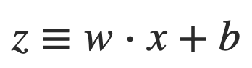
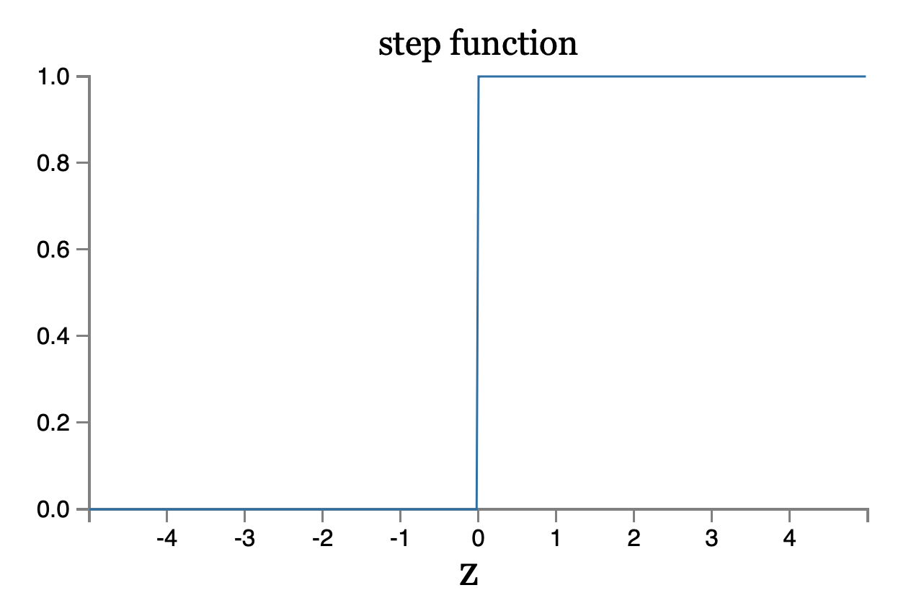
Perceptron

Slide 60
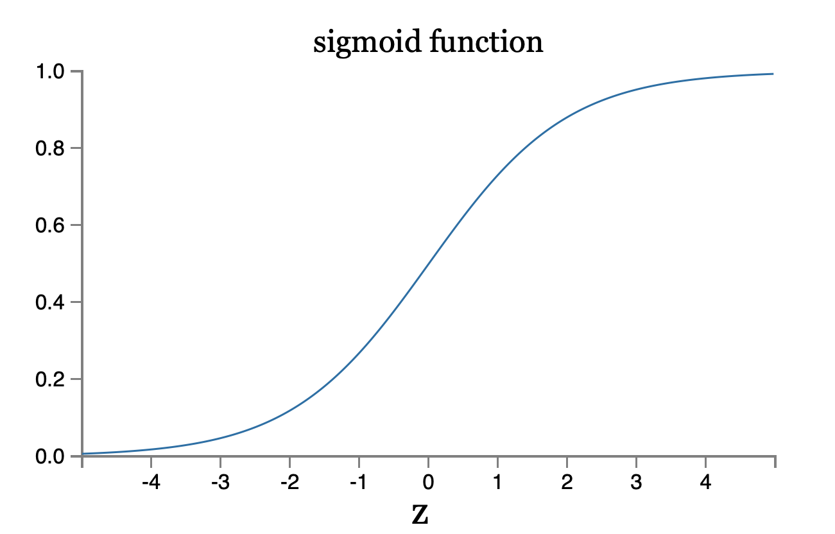
Sigmoid neuron
Notes:
To understand the similarity to the perceptron model, suppose z≡w⋅x+bz≡w⋅x+b is a large positive number. Then e^−z≈00 and so σ(z)≈1. In other words, when z=w⋅x+b is large and positive, the output from the sigmoid neuron is approximately 1, just as it would have been for a perceptron. Suppose on the other hand that z=w⋅x+b is very negative. Then e^−z→∞, and σ(z)≈00. So when z=w⋅x+b is very negative, the behavior of a sigmoid neuron also closely approximates a perceptron. It's only when w⋅x+b is of modest size that there's much deviation from the perceptron model.

Slide 61
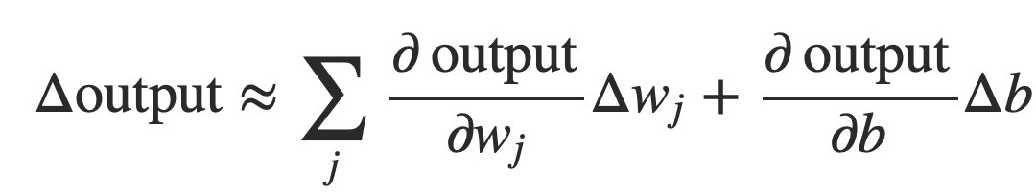
Smoothness is crucial
Smoothness of σ means that small changes in the weights w_{j} and in the bias b will produce a small change the output from the neuron
Δoutput is a linear function of the changes Δwj and Δb
This makes it easy to choose small changes in the weights and biases to achieve any desired small change in the output
Notes:
where the sum is over all the weights, wj and bias b and ∂output/∂wj is the partial derivative of the output with respect to wj. And ∂output/∂b denote partial derivative of the output with respect b.
This linearity makes it easy to choose small changes in the weights and biases to achieve any desired small change in the output. So while sigmoid neurons have much of the same qualitative behaviour as perceptrons, they make it much easier to figure out how changing the weights and biases will change the output.

Slide 62
Next time: Neural Nets
Notes:
https://upload.wikimedia.org/wikipedia/commons/8/84/Ski_Famille_-_Family_Ski_Holidays.jpg

